Slide 1
Tingles for Terminal
Unit 2.1
Cybersecurity Boot Camp |

Slide 2
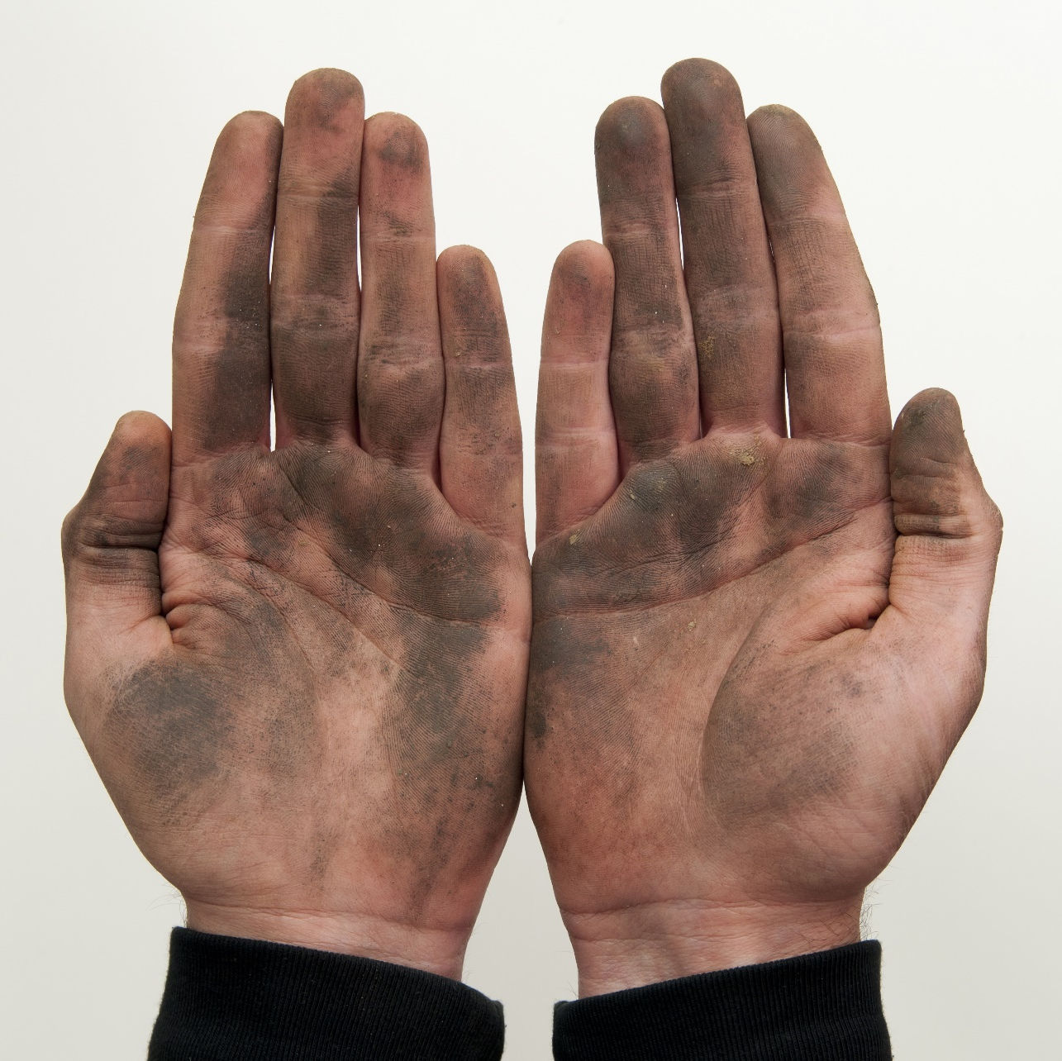
This Week
Welcome Back!
This week, we’ll be getting our hands dirty . . .
Notes:
Review goals; address any questions.

Slide 3
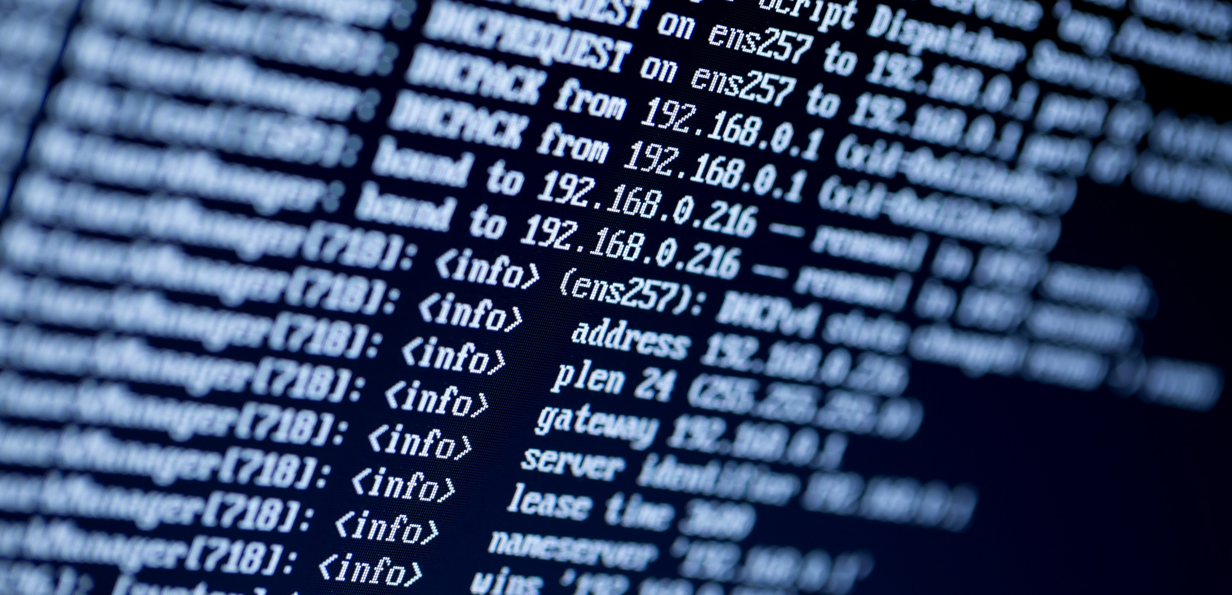
This Week
By working with the command line!
Notes:
Review goals; address any questions.

Slide 4
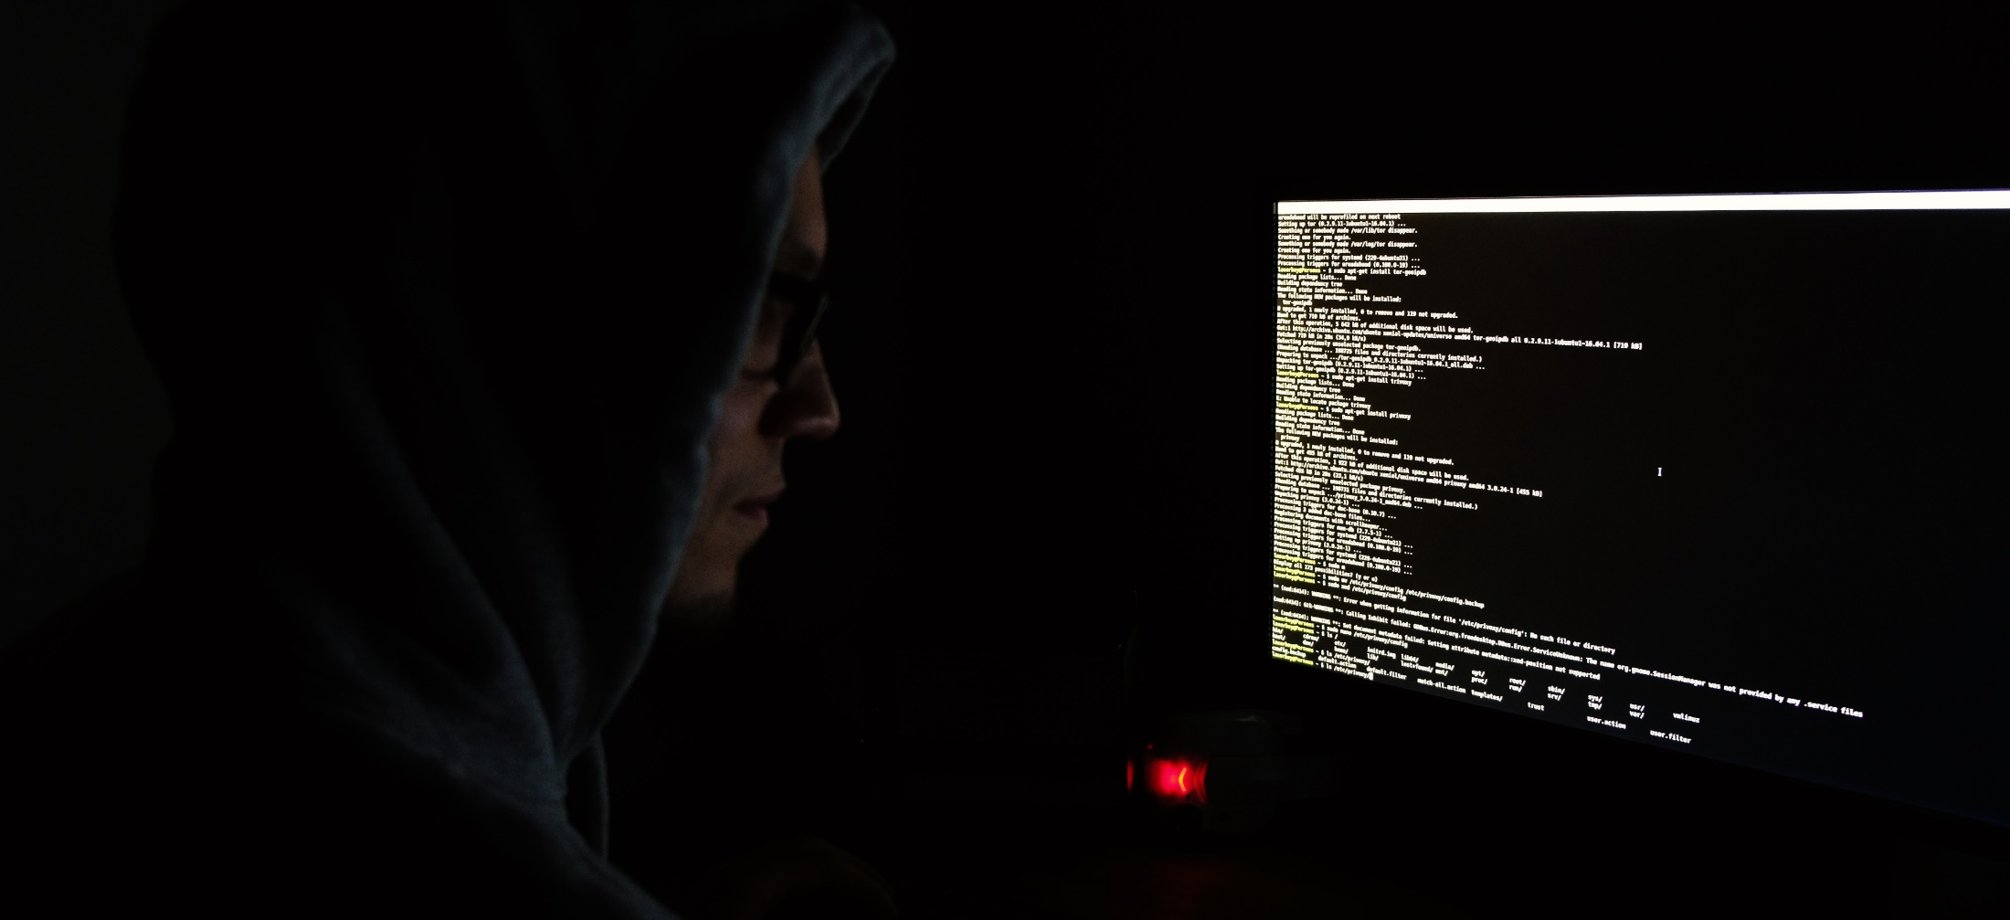
The Mysterious, All Powerful Command Line?
For many newcomers to IT, the command line can seem like something shrouded in mystery. It’s the dark tool of hackers and IT nerds plugging away in the middle of the night.
Notes:
Review goals; address any questions.

Slide 5
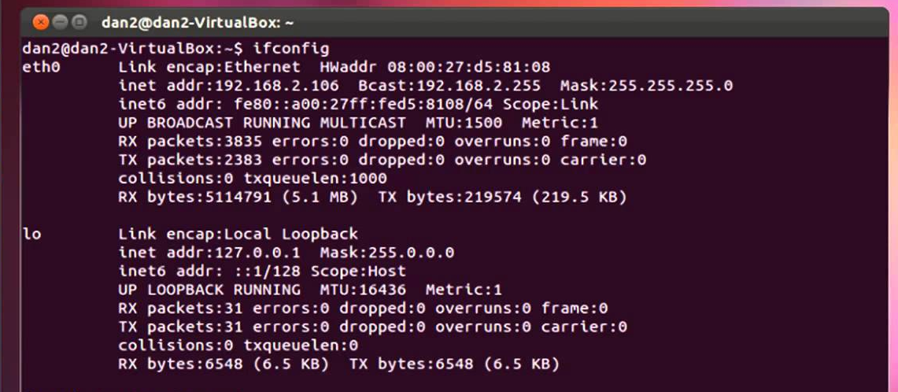
The Mysterious, All Powerful Command Line?
But more often than not, the command line is nothing more than a convenient tool for conducting basic IT operations. Becoming comfortable with it is a rite of passage.
Notes:
Review goals; address any questions.

Slide 6
Today’s Goals
By the end of class, you will be able to:
Explain why the command line is important for IT and security professionals.
Utilize commands like ls, cd, mkdir, touch, cp, mv, and cat for file navigation and manipulation.
Navigate deeply nested folder structures using relative file paths.
Utilize commands like head, tail, and less to preview files.
Combine the above commands to accomplish relevant IT tasks.
$ cd GetStarted
Notes:
Review goals; address any questions.

Slide 7
Why Command Line?

Slide 8

Quick Fist to Five!
Raise a Fist If you’ve never worked with the command line and barely know what it is.
Raise a Five If you work with the command line on a daily basis.
Raise a One, Two, Three, or Four
If you fall somewhere in between.
Notes:
Review goals; address any questions.

Slide 9
Quick Fist to Five!
Story Time
For those of you who have used the command line, where have you used it and what for?
Notes:
Review goals; address any questions.

Slide 10
Why Learn the Command Line?
As security professionals, the command line is
The only way to achieve a desired outcome. In many cases, you will find yourself working with a system or set of tools with no GUI interface to use at all. This is typical of many servers. The command line will be your only mode for configuration.
The fastest way to achieve a desired outcome. With powerful tools and an ability to execute repeatable scripts, the command line can speed up processes that require significant manual effort.
The most flexible way to achieve a desired outcome. While working with a GUI may be the most familiar, working directly with the command line provides greater control than the standard GUI. You will be able to output logs directly where you like, combine files in unique ways, and string together commands more liberally.
Notes:
Review goals; address any questions.

Slide 11
Why Learn the Command Line?
As security professionals, the command line is seen as
A critical core competency for the job. There’s no bones about it. Knowing how to use the command line is a near necessity for any IT-oriented job in the security space. When it comes to basic tasks like penetration testing, vulnerability assessment, user permissioning, and system configuration—command-line literacy is a must.
Notes:
Review goals; address any questions.

Slide 12
Why Learn the Command Line?
As security professionals, the command line is seen as
A critical core competency for the job. There’s no bones about it. Knowing how to use the command line is a near necessity for any IT-oriented job in the security space. When it comes to basic tasks like penetration testing, vulnerability assessment, user permissioning, and system configuration—command-line literacy is a must.
Rest Assured
We’ll be spending a lot of time with the command line in this program.
Notes:
Review goals; address any questions.

Slide 13

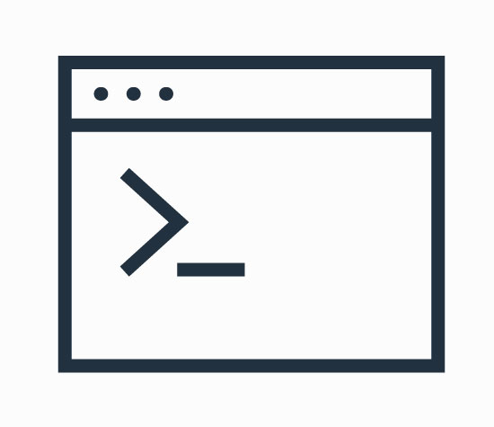
Words to the Wise
A few tips to follow:
The best way to learn the command line is to use it.
This week will be heavily oriented around hands-on activities.
Take notes during each demo and try your best on the activities.
Remember practice makes perfect!
Notes:
Review goals; address any questions.

Slide 14
Activity Time!

Slide 15
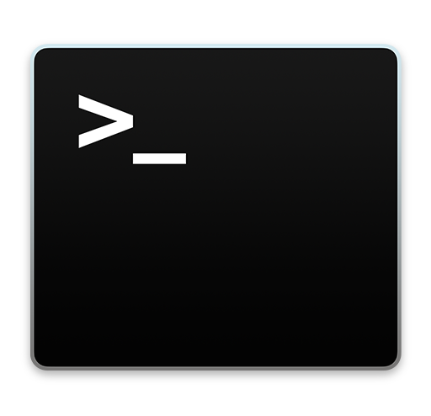

Terminal and Git Bash
Mac (Terminal)
Windows (Git Bash)
In this program, we’ll be focused on learning the Unix command line.
Notes:
Review goals; address any questions.

Slide 16
Activity: Setup Time (10 min)
Take a moment to install and locate your instance of the command line.
Windows Users
Go to https://gitforwindows.org to download the Git Bash .exe file for your computer.
Double-click the .exe you downloaded and accept the default settings to complete the installation.
After the installation is complete, double-click the Git Bash icon to open the terminal window.
Mac Users
No installation needed!
Select Command + Space to open Launcher.
In the search box, type Terminal and then hit Enter to open the Terminal window.

Slide 17
Basic Terminal Commands
Instructor Demo
Notes:
Review goals; address any questions.

Slide 18
Activity: MyHacks Folder (10 min)
Using only the command line, complete the following:
Create a folder on your desktop called MyHacks.
Navigate into the MyHacks folder.
From within the MyHacks folder, print the working directory.
Create three files inside the MyHacks folder: DoS.txt, Phishing.txt, and Keylogger.txt.
Display all of the files created.
Open the folder in your file explorer.
Clear the terminal history.

Slide 19
Relative Paths
Instructor Demo
Notes:
Review goals; address any questions.

Slide 20
Activity: Terminal Mazes (15 min)
Instructions
We just provided you with three folder mazes. Each folder maze is composed of a set of deeply nested subfolders. At the base of each folder is a file called start.txt.
Your task is to copy the start.txt file into the End folder that is buried somewhere in the maze of folders. You may use only one copy command as part of each solution.
Hints
Your final solutions should each take the form of: cp start.txt ./Left/Left/Right/Left/End/
See the file tree sent to you for a breakdown of Maze 1 and Maze 2.

Slide 21
Activity: Terminal Decor (15 min)
Using only the terminal, complete the following tasks:
Create a folder on the desktop called My_House.
Inside the My_House folder, create three subfolders: Bedroom, Living_Room, and Kitchen.
Navigate into the Living_Room folder and create two files called tv.txt and sofa.txt.
Navigate into the Kitchen folder and create two files called oven.txt and sink.txt.
Navigate into the Bedroom folder and create a file called bed.txt and a folder called Bathroom.
Copy the sink.txt file from the Kitchen folder into the Bathroom folder.
Move the tv.txt file from the Living_Room folder and into the Bedroom folder.
Record all the commands you used into a new file (you can save it anywhere) called Decor.sh.
When all steps are complete, your file tree should look like the one sent to you.

Slide 22
Preview Command
Instructor Demo
Notes:
Review goals; address any questions.

Slide 23
Activity: Preview Practice (7 min)
Instructions
You've just been given a zip folder allegedly filled with chapters from a book in text format.
Use the head, less, and tail commands to preview each of the files.
Be sure to use each command and specify a number of lines at least once.
Be ready to state which is not actually a text file in your opinion.

Slide 24
cat Command
Instructor Demo
Notes:
Review goals; address any questions.

Slide 25
Activity: Great Library (10 min)
Instructions
You've just been given a folder allegedly filled with books.
Your task is to sift through each of the book files and complete the following steps:
Identify which files are text based.
Combine these files into a single text file called full.txt.
Confirm that the combination worked successfully, before moving the new file to a folder called Summary.
Bonus: See if you can determine the correct file format of the non-text file. Rename the file extension and be ready to share what you have found. (Hint: Read the gibberish.)

Slide 26
Lesson Recap

Slide 27
Quick Review!
Which command would we use to retrieve a list of all files in a folder?
Notes:
Review goals; address any questions.

Slide 28
Quick Review!
Which command would we use to retrieve a list of all files in a folder?
ls
Notes:
Review goals; address any questions.

Slide 29
Quick Review!
Which command would we use to create a folder?
Notes:
Review goals; address any questions.

Slide 30
Quick Review!
Which command would we use to create a folder?
mkdir
Notes:
Review goals; address any questions.

Slide 31
Quick Review!
Which command would we use to create a file?
Notes:
Review goals; address any questions.

Slide 32
Quick Review!
Which command would we use to create a file?
touch
Notes:
Review goals; address any questions.

Slide 33
Quick Review!
What do the
explorer . and open .
commands do?
Notes:
Review goals; address any questions.

Slide 34
Quick Review!
What do the
explorer . and open .
commands do?
They each open the present working directory in the file explorer.
Notes:
Review goals; address any questions.

Slide 35
Quick Review!
Which command(s) could we use to preview a file’s contents?
Notes:
Review goals; address any questions.

Slide 36
Quick Review!
Which command(s) could we use to preview a file’s contents?
head
tail
less
Notes:
Review goals; address any questions.

Slide 37
Quick Review!
Which command would we use to combine two files together? How would we make it so the output was saved?
Notes:
Review goals; address any questions.

Slide 38
Quick Review!
Which command would we use to combine two files together? How would we make it so the output was saved?
cat
cat {files} >
Notes:
Review goals; address any questions.

Slide 39
Today’s Summary
ls: Lists all files in a directory
cd {folder}: Change directory
mkdir {folder}: Make a new folder
touch {file}: Make a new file
cp {file} {destination}: Copies a file
mv <file> {destination}: Moves a file
cat {files}: Combines files
head: Previews first 10 lines of a file
tail: Previews last 10 lines of a file
less: Opens file previewer
Notes:
Review goals; address any questions.

Slide 40
Today’s Summary
ls: Lists all files in a directory
cd {folder}: Change directory
mkdir {folder}: Make a new folder
touch {file}: Make a new file
cp {file} {destination}: Copies a file
mv <file> {destination}: Moves a file
cat {files}: Combines files
head: Previews first 10 lines of a file
tail: Previews last 10 lines of a file
less: Opens file previewer
Tip: We covered a lot today!
And there’s plenty more to come. Be sure to spend time before next class, redoing and practicing today’s exercises to build proficiency.
Notes:
Review goals; address any questions.

Slide 41
Today’s Goals
By the end of class, you will:
Explain why the command line is important for IT and security professionals.
Utilize commands like ls, cd, mkdir, touch, cp, mv, and cat for file navigation and manipulation.
Navigate deeply nested folder structures using relative file paths.
Use commands like head, tail, and less to preview files.
Combine the preceding commands to accomplish various IT tasks.
$ cd GetStarted
Notes:
Review goals; address any questions.

Slide 42

Self Checkup
If this is you . . . that’s okay!
Notes:
Review goals; address any questions.

Slide 43

Self Checkup
If this is you . . . even better!
Notes:
Review goals; address any questions.

Slide 44
Self Checkup
Tip: As with all skills, proficiency will build the more you practice increasingly challenging problems.
Just keep at it!
Notes:
Review goals; address any questions.

Slide 45
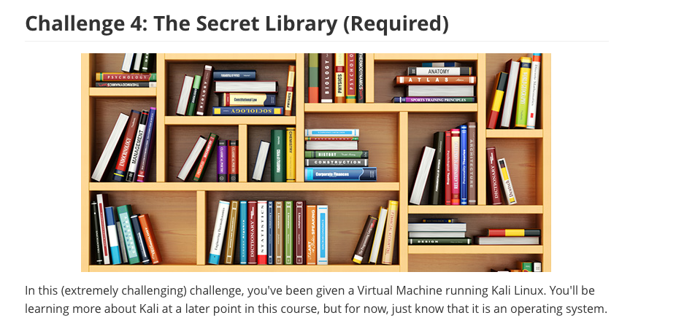
Homework Assignment
You will pick 3 of 4 Command-Line Challenges.
Due Date: One Week from Next Class
(Don’t get started just yet. There’s still more to learn!)

Slide 46
Next Class
find
exec
grep
And a Lot More!

